Slide 1
When Failure Cuts
A conversation on how failure can be especially difficult for high achieving and intelligent individuals.

Slide 2
Disclaimer
The author of this slide deck and presentation does not represent to be a health care professional. Any statements or artifacts presented should not be construed as medical advice. Although efforts were made to collect and share reliable information this talk is not intended to represent a comprehensive body of knowledge and may not reflect information that is relevant to you.
If you have questions or are curious about topics in this discussion you should speak to a licensed healthcare professional.
(I’m just some dude, don’t listen to me.)

Slide 3
Hi, I’m Dan.
Unemployed since May
Second time in my career, the last only lasted three weeks.
Lots of letters behind my name:
CISA, CISSP, PMP, Prosci, GIAC-SSAP, SHRM-CP, etc.
MS, ABD-EdD, MS #2 in 2025
High IQ, side saddled w/ ADHD 🐿️ and anxiety mixed in.
Dealt with D³ these past few months.
Doubt
Defeat
Depression

Slide 4
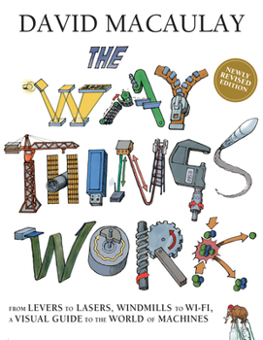
The Hacker Mindset
Understanding the why, and the how, behind our world and the creations within it.
A belief that everything can be explained, any problem can be solved, and any obstacle overcome.
A relentless curiosity, identifying confines and constraints, what makes things the way they are?

Slide 5
The Questions
Why am I out of work?
What can I do differently?
What caused this to happen?
How long will this last?
What if this is just it?
Why is D³ such a devastating crush!?!? (Doubt, Defeat, Depression)

Slide 6
Am I the only one who feels this way?
Think silently for a moment…

Slide 7
Am I the only one who feels this way?
So, like any good nerd, what does peer review research tell us?

Slide 8
Research Tip You should always purchase academic journal articles directly or use college and university libraries. Remember that sites like sci-hub.se may be legal in Sweden, but they are prohibited elsewhere.

Slide 9
Physical Health

Slide 10
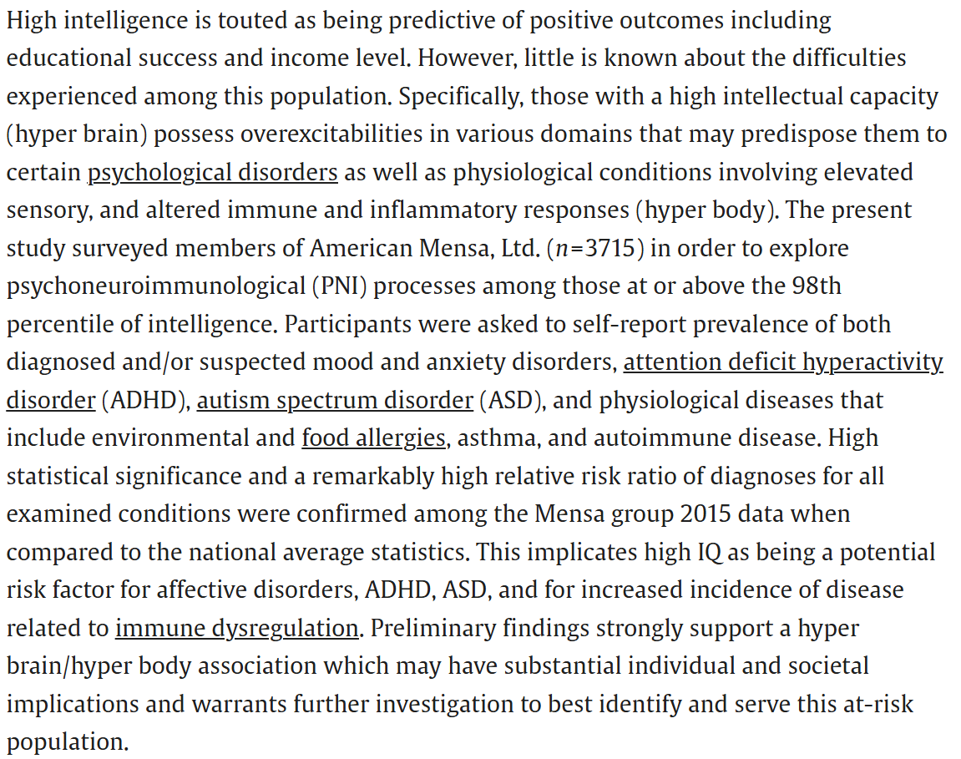
High intelligence: A risk factor for psychological and physiological overexcitabilities. (Karpinski, 2018)
https://doi.org/10.1016/j.intell.2017.09.001

Slide 11
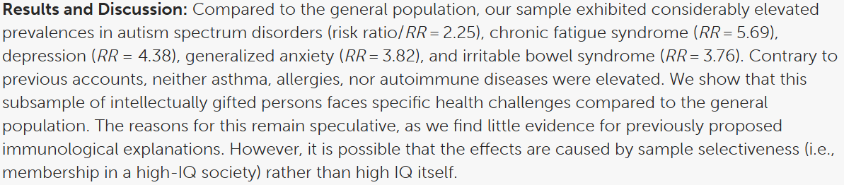
Bright, but allergic and neurotic? A critical investigation of the “overexcitable genius” hypothesis. (Fries, 2022)
https://doi.org/10.3389/fpsyg.2022.1051910

Slide 12
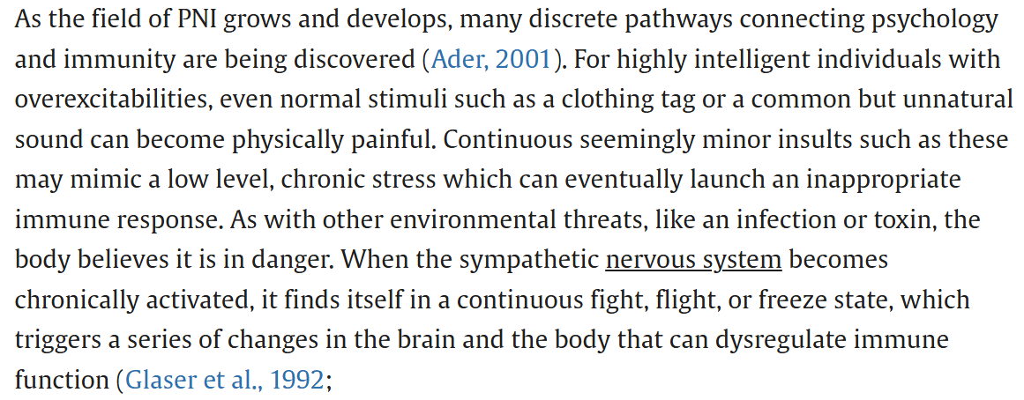
But Why? …
https://doi.org/10.1016/j.intell.2017.09.001

Slide 13
But Why? …
https://doi.org/10.1016/j.intell.2017.09.001

Slide 14
Mental Health

Slide 15
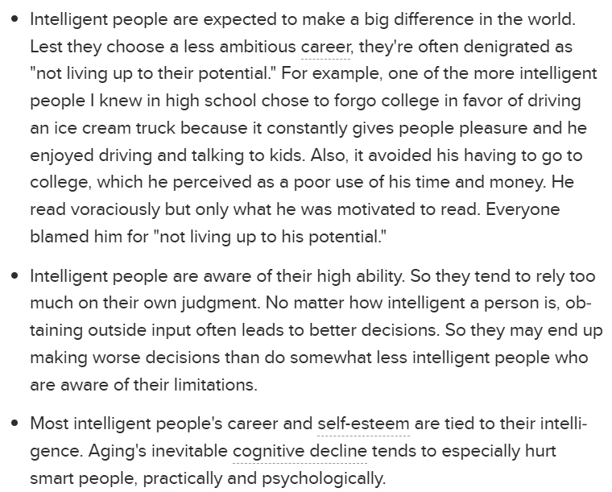
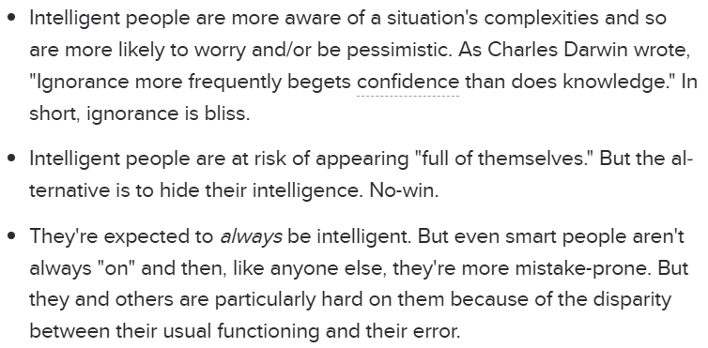
Psychology Today: The Burdens of Intelligence Marty Nemko, September 2016

Slide 16
Rationality and Intelligence K. Stanovich, M. Toplak, R. West
We get surprised when someone whom we consider to be smart acts stupidly. When someone we consider to be not so smart acts stupidly, we tend not to be so surprised. But why should we be so surprised in the first case? A typical dictionary definition of the adjectival form of the word “smart” is “characterized by sharp quick thought; bright” or “having or showing quick intelligence or ready mental capacity.” Thus, being smart seems a lot like being intelligent, according to the dictionary. Dictionaries also tell us that a stupid person is “slow to learn or understand; lacking or marked by lack of intelligence.” Thus, if a smart person is intelligent and “stupid” means a lack of intelligence, then the “smart person being stupid” phrase seems to make no sense.
https://doi.org/10.7551/mitpress/11252.001.0001

Slide 17
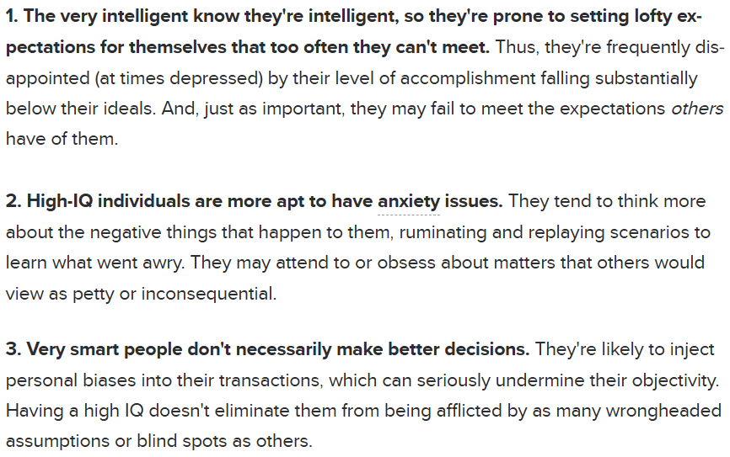
13 Reasons Why a High IQ Can Make You Less Happy Psychology Today: Leon Seltzer, 2021

Slide 18
Where We May Struggle

Slide 19
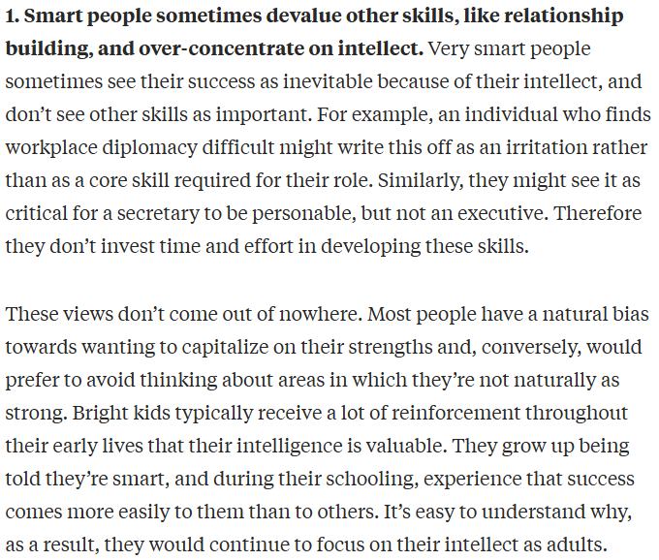
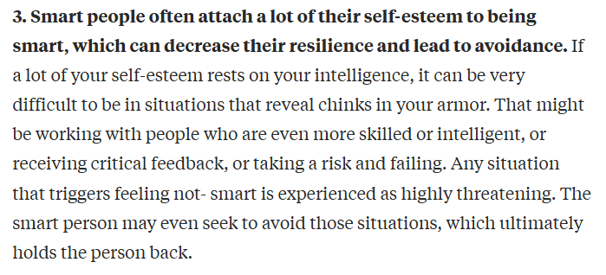
HBR: 5 Ways Smart People Sabotage Their Success Alice Boyes, November 13, 2018

Slide 20
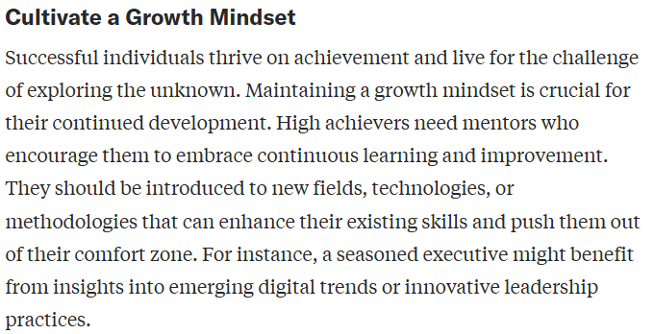
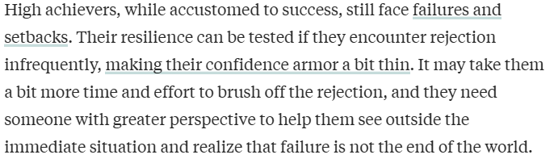
HBR: What High Achievers Need from Their Mentors by Ruth Gotian and Andy Lopata, August 19, 2024

Slide 21
Is intelligence related to perfectionism? J Lavrijsen, B Soenens, M Vansteenkiste, K Verschueren (2020)
Cognitive ability is related to a higher pursuit of personal standards, yet does not constitute a risk factor for excessive concerns about mistakes.
https://doi.org/10.1111/jopy.12606

Slide 22
How Can We Face It?

Slide 23

Dealing with the monkey…

Slide 24
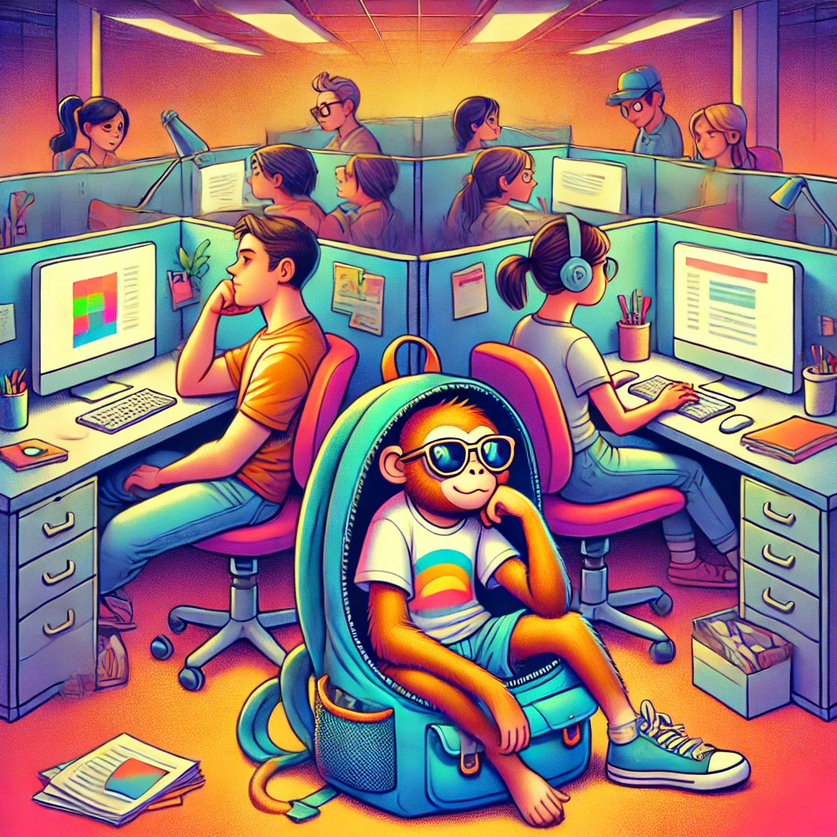
Dealing with the monkey…

Slide 25
Apply Research to Our Failures

Slide 26
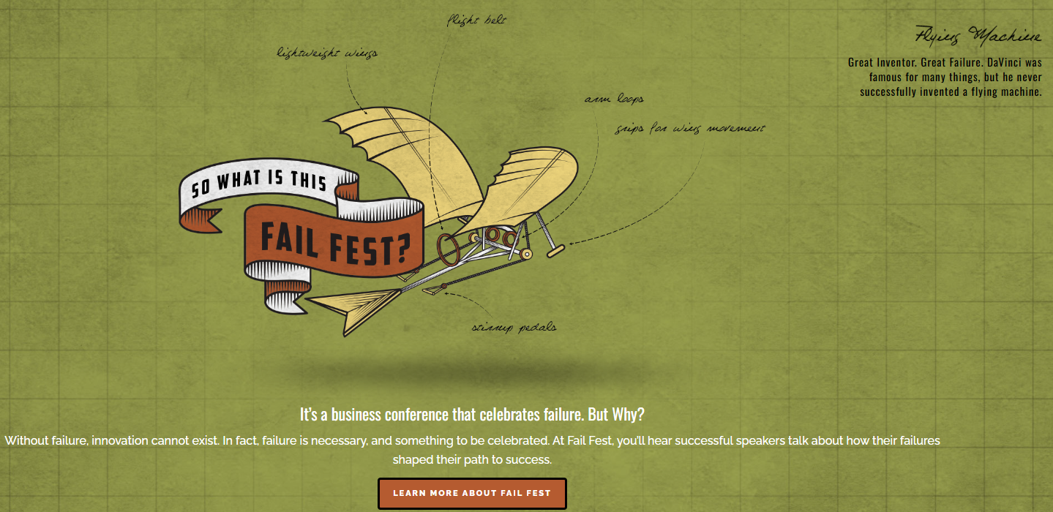
Celebrate Failures

Slide 27
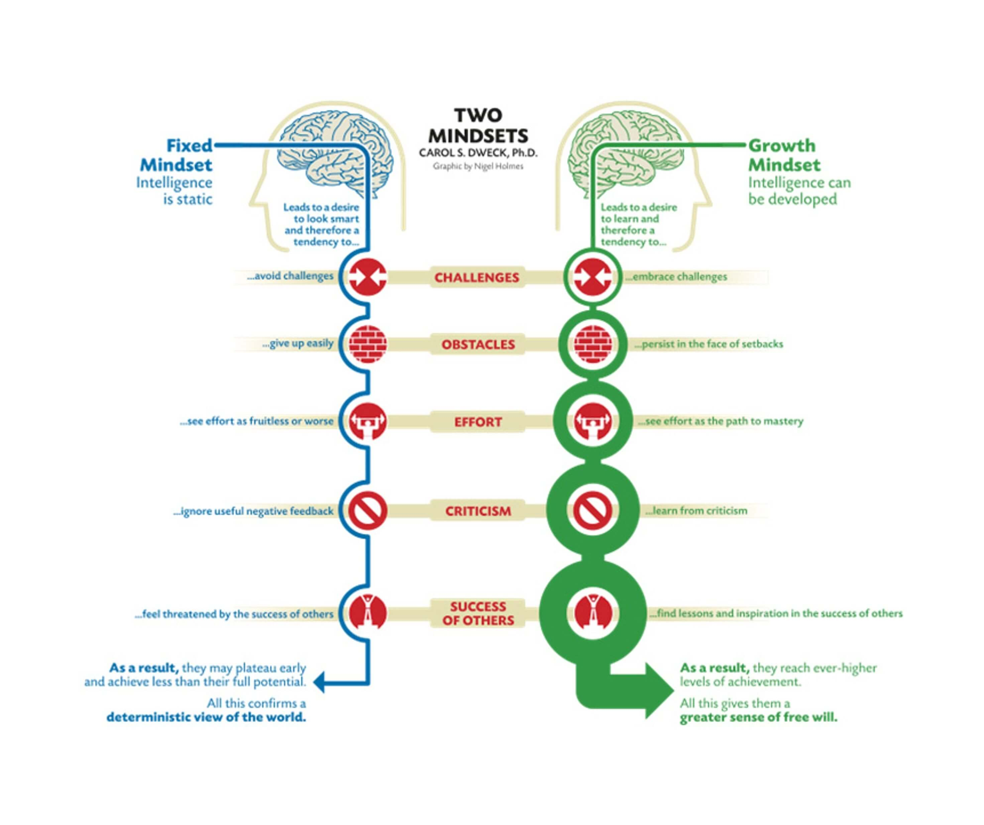
Adopt a Growth Mindset

Slide 28
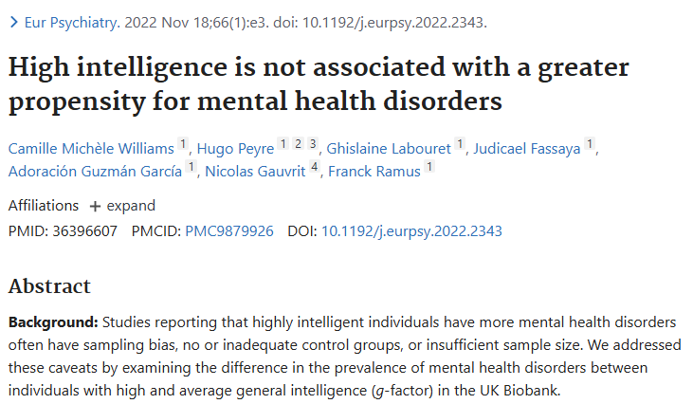
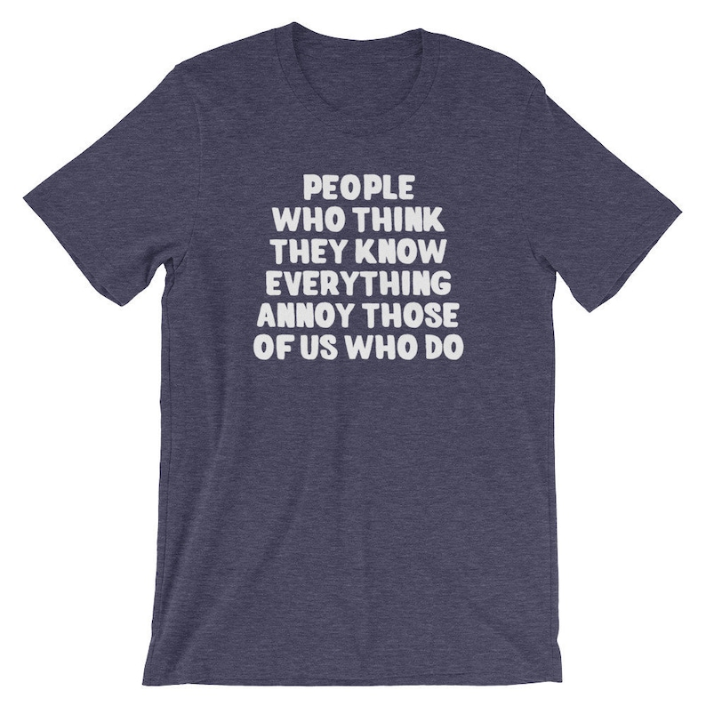
Conclusion

